Slide 1
Intel SGX Explained 6.2 Memory Access Protection
Seehwan Yoo
Dankook University

Slide 2
6.2 SGX Memory access protection
Isolating enclave from the other memory regions
Also, isolate enclave from another enclave
MEE plays an role, but not the core protection mechanism
MEE is at the memory controller, an edge of memory hierarchy
Memory access checks is the core
Non-enclave software can access outside PRM
Code inside enclave can access non-PRM
EPC pages owned by the enclave
Memory access check is conducted when PMH (page miss handler) works, which only handles TLB miss

Slide 3
6.2.1 Functional description
Page table mgmt. in OS; it cannot trust the SW to set up the page tables in any particular way
Address translation can be rejected before it reaches TLB
All SW uses virtual address, all the micro-ops use virtual addresses
Handled by TLB before the actual memory access
By contrast, CPU’s microcode has the ability to issue physical memory access, which bypass the TLB
SGX uses microcode, so they can bypass TLB, and access memory such as EPC page holding SECS
SGX address translation checks use the information in EPCM (enclave page cache map)
Inverted page table that covers the entire EPC

Slide 4
Security checks in enclave mode
First, VA inside enclave virtual memory range (ELRANGE) must be translated into PA inside EPC
If we are in enclave VA, the corresponding PA should be under EPC
SGX disallow having enclave code outside ELRANGE (set XD on TLB entry)
Second, EPC must only be accessed by the enclave who owns the page
SECS page index inside EPC: enclave id (CR_ACTIVE_SECS, microcode register)
EPCM entry has enclave id; compare with the current enclave id
Third, some EPC cannot be accessed from software
SECS, TCS, VA (hardware-defined structure) only be accessed by SGX microcode
PMH rejects address translation targeting these pages
Blocked EPC: swap-outed process pages
EPC pages must be accessed using the VA associate with them
EADD.LINADDR: → EPCM.LINADDR == faulting addr

Slide 5
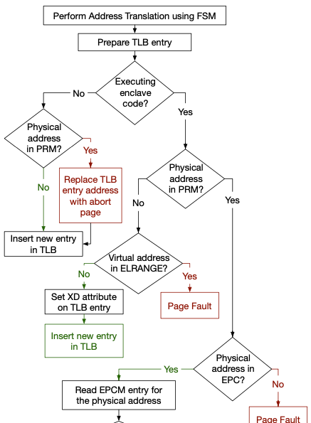
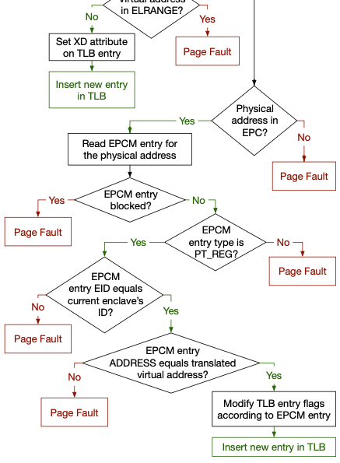
PMH modifications for SGX

Slide 6
3 implementation options
Checking logic can be implemented
All in microcode
Least HW modification
All PMH goes through microcode checking logic
Some in HW register ELRANGE + in microcode
Better in terms of performance (PMH outside enclave do not touch microcode)
Rare cases to run outside the enclave
All in HW
Best performance, but
Gain is not so dramatic (TLB miss is infrequent)
Leads to page fault handler and AEX(async. Enc. Exit) to be the bottltneck in performance

Slide 7
Security check - correctness
At all times all the TLB entries in every logical processor will be consistent with SGX＇s security guarantee
Assure that all the memory access by software obey SGX＇s security model
Top-level invariants breakdown
Logical processor (LP) is outside the enclave, ELRANGE to be empty
Inv.1: At all times when LP is outside enclave mode, its TLB may only contain physical address belonging to DRAM pages outside PRM
Inv. 2: At all times when LP is inside enclave mode, the TLB entries for virtual address outside the current enclave＇s ELRANGE must contain physical addresses belonging to DRAM pages outside PRM
Inv. 3: At all times when LP is in enclave mode, the TLB entries for VA inside the current enclave＇s ELRANGE must match the virtual memory layout specified by the enclave author

Slide 8
Top-level invariants breakdown
Enclave ← → non-enclave mode transition (at a few well-defined points)
EENTER, ERESUME, EEXIT and AEX
Flush TLB and OoO pipeline: TLB empty after every mode transition
Initialization
Loading some MSR triggers TLB flush
When modifying MTRR, TLB flush
Enabling SGX → Adding MTRR → TLB flush, OoO pipeline flush

Slide 9
Top-level invariants proofs
Inv. 1 proof
LP is outside enclave mode, SGX security checks added to the PMH reject any addr translation that would point into the PRM before it reaches the TLB
PRM never changes after SGX is enabled on LP
Inv. 2 proof
While an LP is executing an enclave code, SGX memory access checks added to PMH reject any addr translation to physical addr inside PRM if VA falls outside the current enclave＇s ELRANGE
ELRANGE change→ TLB flush : empty TLB satisfies inv.
Inv. 3 proof
EPCM (EPC map) virtual memory layout given by the enclave author
Sub-inv 1. At all times, each EPCM entry matches virtual mem layout desired by the enclave author
Sub-inv 2. Assume EPCM is constant, at all times when LP is in enclave mode, the TLB entry for VA inside the current enclave ELRANGE must match EPCM entries that belong to the enclave

Slide 10
Top-level invariants proofs
Inv. 3 proof
EPCM (EPC map) virtual memory layout given by the enclave author
Sub-inv 1. At all times, each EPCM entry matches virtual mem layout desired by the enclave author
Sub-inv 2. Assume EPCM is constant, at all times when LP is in enclave mode, the TLB entry for VA inside the current enclave ELRANGE must match EPCM entries that belong to the enclave
Sub-inv 3. An EPCM entry is only modified when there is no mapping for it in any LP＇s TLB
Inv. 2, 3 prove that all the TLBs in SGX-enabled computer always reflect the content of the EPCM
EPCM is a bridge between the memory layout specification of the enclave authors and TLB entries

Slide 11
EPCM entries reflect enclave author design
Proof outline for inv3.
All instructions that modify EPCM pages allocated to an enclave are synchronized using a lock in the enclave SECS (time-ordered)
EPCM entry created by instructions that can only be issued before EINIT
Between ECREATE and EADD(?) EINIT
Contents of the EPCM entry (by the instructions) contributes to the enclave measurement
Accord. SDM, enclave with incorrect measurement do not exist, as it will be rejected by software attestation
EPCM pages match enclave author＇s memory layout spec
EPCM entries can be evicted to untrusted DRAM, together with corresponding EPC pages by EWB instruction (ELDU/ELDB for re-loading)
If we can prove that EPCM entry that is reloaded from DRAM is equivalent to the evicted entry, then reloaded entry matches the author＇s spec

Slide 12
EPCM entries reflect enclave author design
evicted EPC page contents and associated metadata has to be protected
Out of the scope of the work
Evicted page AES-GMAC
MAC tag by AES-GMAC covers EPCM metadata as well as page date
Includes 64-bit version stored in a version tree whose nodes are version array pages
It follows that EWB will only reload EPCM entry if the contents is equivalent to the evicted entry
Equivalence does not mean perfect equality, allowing evicting EPC page, assoc. EPCM entry
Reloading the page contents to a different EPC page, and fills in different EPCM entry
Loading the contents of EPC page at different physical address does not break VM abstraction (as long as the page is mapped at the same VA, EPCM.LINADDR, and access control attributes

Slide 13
Addr translation attacks prevented by MAC verification
ELDU / ELDB
MAC cover the contents of the evicted EPC page
MAC covers metadata for EPCM entry
EID is covered by the MAC tag (enclave1＇s page cannot migrate to another enclave)
LINADDR is covered by the MAC tag (OS cannot modify virtual memory layout)
Page access permission is covered by the MAC tag
Nonce stored in the VA is covered by the MAC tag (OS cannot replay attack, reverts the contents of EPC page to an old version)

